Slide 1
CS4499/5599: Data Science and Applied Machine Learning
Class Lecture: March 29th, 2023

Slide 2
Objectives
Last time:
Discussed the concept of ensemble learning
Coded up an example using the VoterClassifier
Discussed bagging and pasting with machine learning models
Today:
Continue with ensemble learning using Random Forest
Go over the concept of boosting

Slide 3
Random Forest
In this class we have spent a good amount of time discussing and using decision trees for our classification
Decision trees also a good candidate for use in ensemble learning with what is known as random forest
One issues with ensemble learning is the need for several learners to make an effective model
If you recall when we train a decision tree, we normally will split our data based on the highest entropy or lowest impurity
However, we can train different tree combinations to get the learners we need for ensemble

Slide 4
Random Forest
As with the other ensembles we have discussed, random forests aggregate the solution to derive the final result
Random forest make use of Random Sub-spacing (i.e., random features and bagging) for the aggregation
One of the key differences between a single decision tree and a random forest is that decision tree algorithms seeks to find the best split in the data
A random forest model looks to increase randomness when training the model, which gives us more diversity in our trees and a better performing model

Slide 5
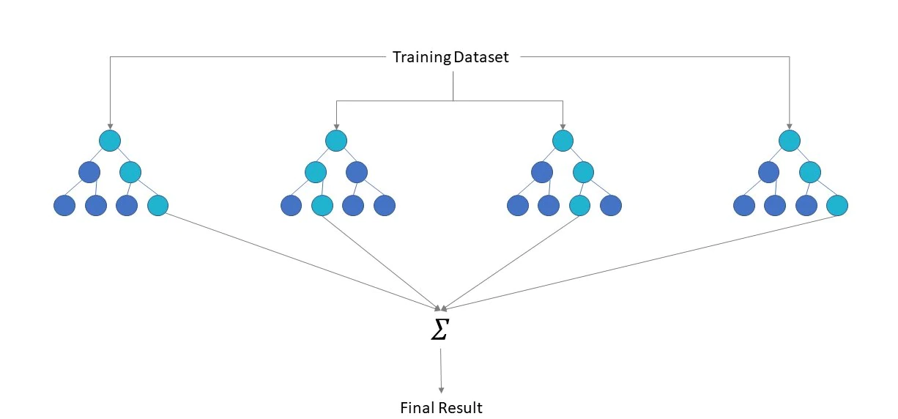
Random Forest
Source: IBM Cloud Education: “Random Forest “

Slide 6
Random Forest Classifier
At its core, the sklearn random forest model simply uses the BaggingClassifier we discussed last time with a decision tree model
However, sklearn has created a class that we can use for a random forest sklearn.ensemble.RandomForestClassifier
The hyperparameters for the random forest classifier are very similar to those of the decision tree
We can select to train our tree using Gini Impurity or Entropy and we can also select a max depth for the trees
Sklearn also allows us to limit the number of trees in our model as well as the number of features used

Slide 7
Extra Trees Classifier
Sklearn has another ensemble tree classifier known as Extremely Randomized Trees Classifier or Extra Trees Classifier
This method is very similar to random forest, except in the way the tree is constructed
The Extra Tree Classifier will try random thresholds for each feature rather than using the best one as a single tree does
This introduces more randomness to our trees and is faster than a random forest model
It should be noted that the only way to know which approach is better is to actually train the model and evaluate

Slide 8
Random Forest Regression
Sklearn has a class that support training of regression models using forests sklearn.ensemble.RandomForestRegressor
The class works the same has the classifier except we evaluate using MSE, RMSE and R² rather than accuracy
Just like with classification we aggregate the results of our different trees to derive a value based on our data
The hyperparameters for this type of model are the same as the classification model and sklearn has support for Out of Bag evaluation, pasting, etc.

Slide 9
Feature Importance & Plotting
A major advantage of random forest models (and all tree-based models) is the ability to measure feature importance
Sklearn measures importance by taking a weighted average of the decrease in each node’s impurity (across all trees)
The higher importance, the more impact the feature is expected to have on the model
Sklearn also has support to plot individual trees from a random forest model
This process can be a little more involved since we need to extract the specific tree, we want from the graph that stores the model

Slide 10
Benefits of Random Forest Models
To summarize, random forest models have several advantages over other ensemble approaches
Easy to implement ensemble method
Can help address overfit compared to single decision tree models
Can be visualized and easily explained
Feature importance can provide insight on our model and its performance
Note that like all ensemble methods, a random forest will take more time to train single trees

Slide 11
The Iris Dataset
Today we will utilize a very famous dataset used in machine learning, the Iris dataset collected by Ronald Fisher
This data contains 50 samples of three different iris species (virginica, versicolor and setosa)
Each sample has four features (the length and width of the petals and sepals)
The original goal when this data was collected was to develop a model that could classify an iris based on these features
This data was collected in 1936 and was one of the first attempts at developing a classification model ever published

Slide 12
Boosting
Hypothesis Boosting (or just Boosting) refers to any ensemble method that combines several weak learners into a strong learner
The key difference with Boosting is our approach, with Boosting we train our predictiors sequentially, with each predictor trying to correct its predecessor
Today there are two popular approaches for boosting:
AdaBoost
Gradient Boost

Slide 13
AdaBoosting
Adaptive Boosting or AdaBoost is a technique that tries to improve upon the predecessor by focusing in on predictors that were underfit
The advantage of this is it allows our model to focus on the areas where it has issues (the instances that are hard to classify)
For example, assume we train a decision tree and make predictions using testing data, AdaBoosting will then increase the weights of the incorrect classifications
Then the model is re-trained using the new weights, this process is then repeated as much as needed

Slide 14
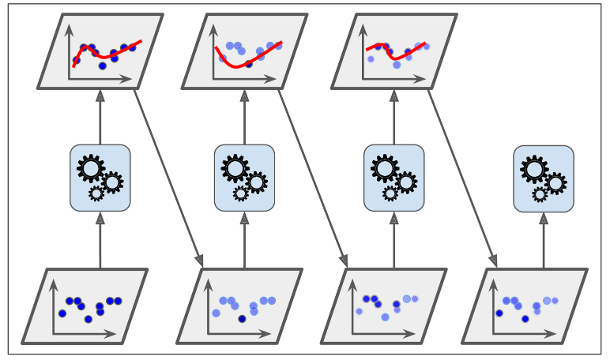
AdaBoosting
Visualization of the AdaBoost Algorithm from Geron

Slide 15
AdaBoosting
Its important to note that the learning rate for the weights does decrease with each iteration
Once all the predictors are trained AdaBoost models behave similar to bagging models
There is one major drawback when using approaches like AdaBoost, that is processing time
Since each iteration is dependent on its predecessor, we cannot make use of parallel processing to speed up training
AdaBoost models also have a tendency to become overfit with each iteration

Slide 16
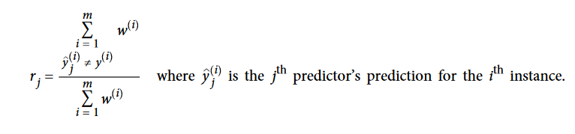

AdaBoosting Algorithm
AdaBoost uses this equation to calculate the initial error rate (r_{j} ), the initial weight is set to 1/m
AdaBoost will then calculate a predictor weight (learning rate η can be adjusted)

Slide 17
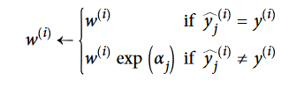

AdaBoosting Algorithm
Next AdaBoosting updates the weights based on the following rules:
The algorithm normalizes the weights, and training is repeated
The algorithm stops when the it reaches the specified number of iterations
Predictions are made based on a weighted majority vote of all the predictors:

Slide 18
AdaBoosting in Sklearn
The sklearn class sklearn.ensemble.AdaBoostClassifier allows for applying AdaBoost to a machine learning model
This class makes use of the SAMME (Stagewise Additive Modeling using Multiclass Exponential) Loss Function
If we are performing binary classification, this is the AdaBoost algorithm we went over
However, this lets us perform multiclass classification as well
Sklearn also has a SAMME.r (for real) which makes use of probabilities rather than weights

Slide 19
AdaBoosting in Sklearn
AdaBoost can also be applied to regression models
In regression cases, the algorithm just adjust the weights based on the loss (can be linear, polynomial, etc.)
Otherwise, the algorithm behaves the same as it would in classification
The user can fine tune the model the same way as with the classifier including the number of estimator and whether to use weights or probabilities
The sklearn class for AdaBoot regression is sklearn.ensemble.AdaBoostRegressor

Slide 20
Next Time
Wrap up Ensemble Methods
Gradient Boosting
Stacking
Start discussing other classifiers such as:
Logistic Regression
K- nearest neighbors
Remember the midproject is on Wednesday before class!

